Slide 1
Adding Value to the Advanced Lab
Rudi Michalak, University of Wyoming
AAPT Regional Meeting CO/WY, April 2018

Slide 2
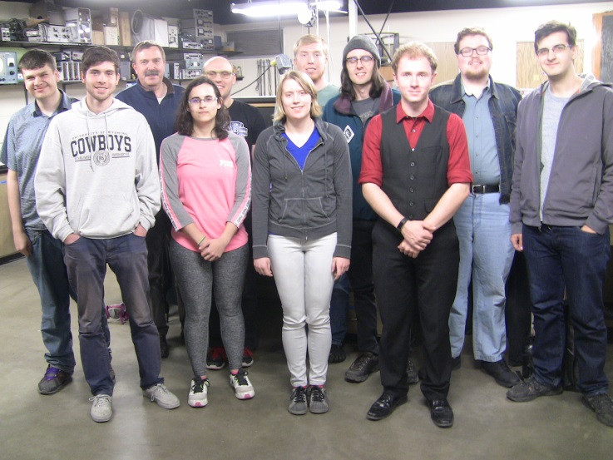
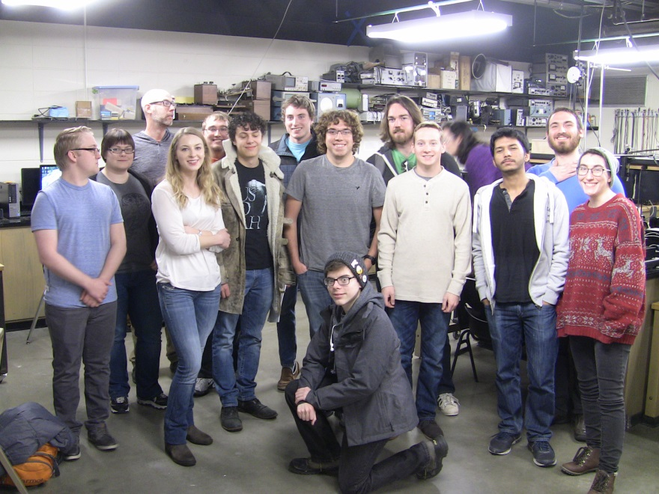
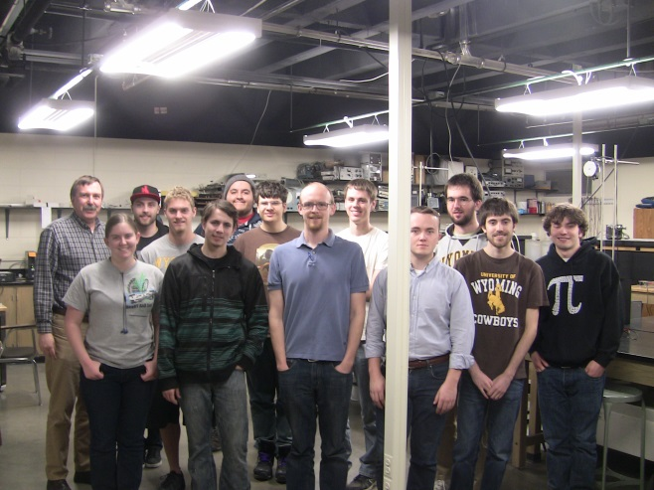
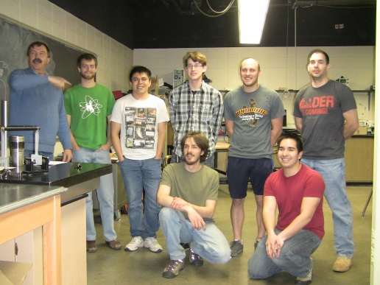
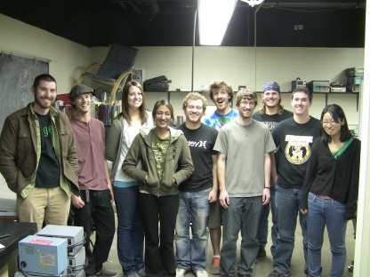
http://physics.uwyo.edu/~rudim/index_3650.html
Spring 2018
2017
2014
2016
2015

Slide 3
The Advanced Modern Physics Lab @ UW
Before
A typical upper level physics lab course:
electronics
data fitting
landmark experiments
unguided report writing
After
Standard Grading w/ Bloom’s Taxonomy
Writing in the Profession
New Dimensions: Oral Prelabs and Exams
increasingly conversations as colleague
Fosters : identification as physicist/ astronomer

Slide 4
Grades
Labs with short reports: 20%
Short report draft 2.5%
Labs with full reports: 35%
Full report draft 2.5%*
Seminar 5%
Midterm : 7.5%
Final exam lab: 15%
Standards: in 4 categories 15%
Full report 9 is a bonus assignment with special rules and deadlines (see below).

Slide 5
Course Assignments
1 equipment seminar talk*
4 short reports* ~ 10 pages
(1 draft)*
4 long reports* ~ 20-35 pages
(1 draft)*
8 oral prelabs
4 oral inlabs
1 oral midterm exam ~ 20 minutes*
1 oral final exam ~ 60 minutes*
In addition to grades * standards can be earned in every assignment.

Slide 6
Dealing with university course regulations: [excerpts]
demonstrate active listening skills
engage opposing viewpoints constructively
Find, analyse, evaluate, and document information
Make effective use of multiple drafts, revision, peer and instructor comments
conventions of spelling, grammar, organizational structure, punctuation, delivery and documentation
discourse of a discipline
Deliver presentations in a confident and professional manner
completing a substantial communication project that requires appropriate research skills
communication standards in a discipline
Recognize and evaluate aspects of communication that respond to the purposes and needs of audiences
Interact effectively with audience members

Slide 7
A twist on standard grading
• three levels loosely following Bloom’s Taxonomy
(1- memorization 2- application 3- analysis & synthesis)
• students earn one level at a time
can repeat as many times as needed
students are encouraged to tackle their weak spots
students can be proactive
• earn standard in
lecture
seminar
prelab
lab work
reports

Slide 8
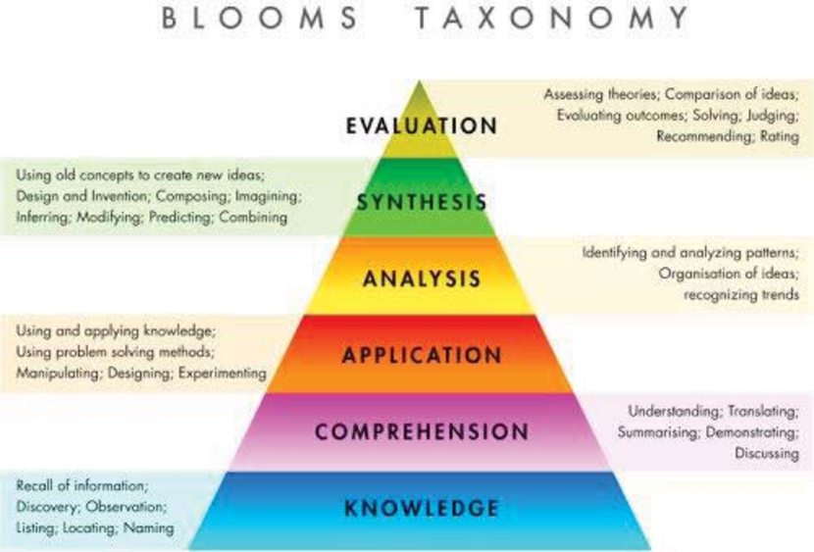
Modified Bloom’s Taxonomy
Streamlined to:
Basic = memorization
Advanced = understanding, application
Proficient = Analysis, synthesis
Bloom, B. S.; Engelhart, M. D.; Furst, E. J.; Hill, W. H.; Krathwohl, D. R. (1956). Taxonomy of educational objectives: The classification of educational goals. Handbook I: Cognitive domain. New York: David McKay Company.

Slide 9
Advanced
‘examine’, ‘identify’, ‘analyse’, ‘select’, ‘infer’, ‘compare’ ,‘illustrate’, ‘correlate’, ‘interpret’
Proficient
‘adapt’, ‘hypothesize’, ‘predict’, ‘model’, ‘convince’, ‘justify’, ‘debate’, ‘plan’, ‘design’, ‘choose’, ‘criticise’, ‘deduce’, ‘defend’
Basic
‘define’, ‘identify’, ‘observe’, ‘state’, ‘record’,
‘remember’, ‘recognize’, ‘locate’, ‘retell’
http://www.maxvibrant.com/images/education/blooms-taxonomy/blooms-taxonomy-chart.jpg
More synonyms of achievement levels.

Slide 10
Examples Standard Grades
Course Scale:
A > 92.5% GPA 4.0
A- > 87.5% 3.67
B+ > 82.5% 3.33
B > 77.5% 3.0
B- > 72.5% 2.67
C+ > 67.5% 2.33
C > 62.5% 2.0
C- > 57.5% 1.67
D+ > 52.5% 1.33
D > 47.5% 1.0
F <= 47.5% 0
4 proficiency 15 100 % A
2 proficiency, 2 advanced 13.5 90 % A-
4 advanced 12 80 % B
3 proficient, 1 unachieved 11.25 75 % B-
2 advanced, 2 basic 10.5 70 % C+
4 basic 9 60 % C-
2 advanced, 2 unachieved 6 40 % F
2 basic, 2 unachieved 4.5 30 % F
4 unachieved 0 0 % F

Slide 11
… more on standard grading
Standards – sub-standards – skills
Standards are what is graded
Experiment |  | Lab & safety skills | Errors | Data decision making
Report |  | Language metrics | Paragraph & chapter design | Chapter content | Bibliography& Research
Math & Theory |  | Preparation | Math & Distributions | Theory & Model | Fitting & Derivation
Oral & COM3 |  | IT & Jargon | Professional Standards | Presentation | Audience & Delivery

Slide 12
Subcategory Example
from Experiment
Example from Math & Theory
Random Error and Systematic Error
Random Identification
Random Ranking
Random: Independent Repetitions
Systematic Identification
Systematic Ranking
Systematic Theoretical/Experimental Correction
Theory and Model
Correctness
Depth
Consequences & Relation to data
Limitations
Bigger Picture
Relation to Other Models
Example from Oral & COM3
Example from Report
Bibliography, Research, & Deadlines
Bib Form and Range
Bib Length and Quality
Research Use in Report
Deadlines, Deadline Negotiation
Quotation, Citation
Drafts & Overcoming Bad Writing Habits
Audience and Confidence/Delivery
Level of Contribution
Engaging & Eloquent
Accessible without Losing Rigor
Verbal Confidence
Body Language
Expertise (No Obtuseness)
https://docs.google.com/spreadsheets/d/1wXR0rcVvBrqhPUD0XmaLrTDMnEMDIenFnQfDTwta3Ck/edit#gid=0

Slide 13
Focus on professional discussions:
Prelabs are professional conversations between instructor and student about topics that relate to a particular experiment. The student can start freely and should choose a topic that she is strong at and/or a topic that will satisfy a needed standard.
The exams are essentially professional discussions among colleagues. Unlike with prelabs this expects a different level of competence in your answers. Emphasis is also put toward professional conduct, which includes behaviour, preparedness, and a number of COM3 categories. One can compare the experience somewhat to presenting a poster at a scientific conference
Inlabs are discussions in a hands-on situation: How did you decide how many data points you need, how many repetitions, which errors dominate, how did you make sure you do not skew your data distributions? This mimics the interactions between a graduate adviser and her graduate student.

Slide 14
Having our lab approved as a COM3 course in USP2015 brought the following advantages:
• the majors learn discipline oriented professional conduct,
oral skills, and writing skills
• students learn to be goal oriented and proactive
• the majors are less resentful of the large writing load
• fewer students will fail the course (report deadline issue)
• opportunities for internal funding of lab equipment

